Slide 1
Spoken language translation
Tanel Alumäe

Slide 2
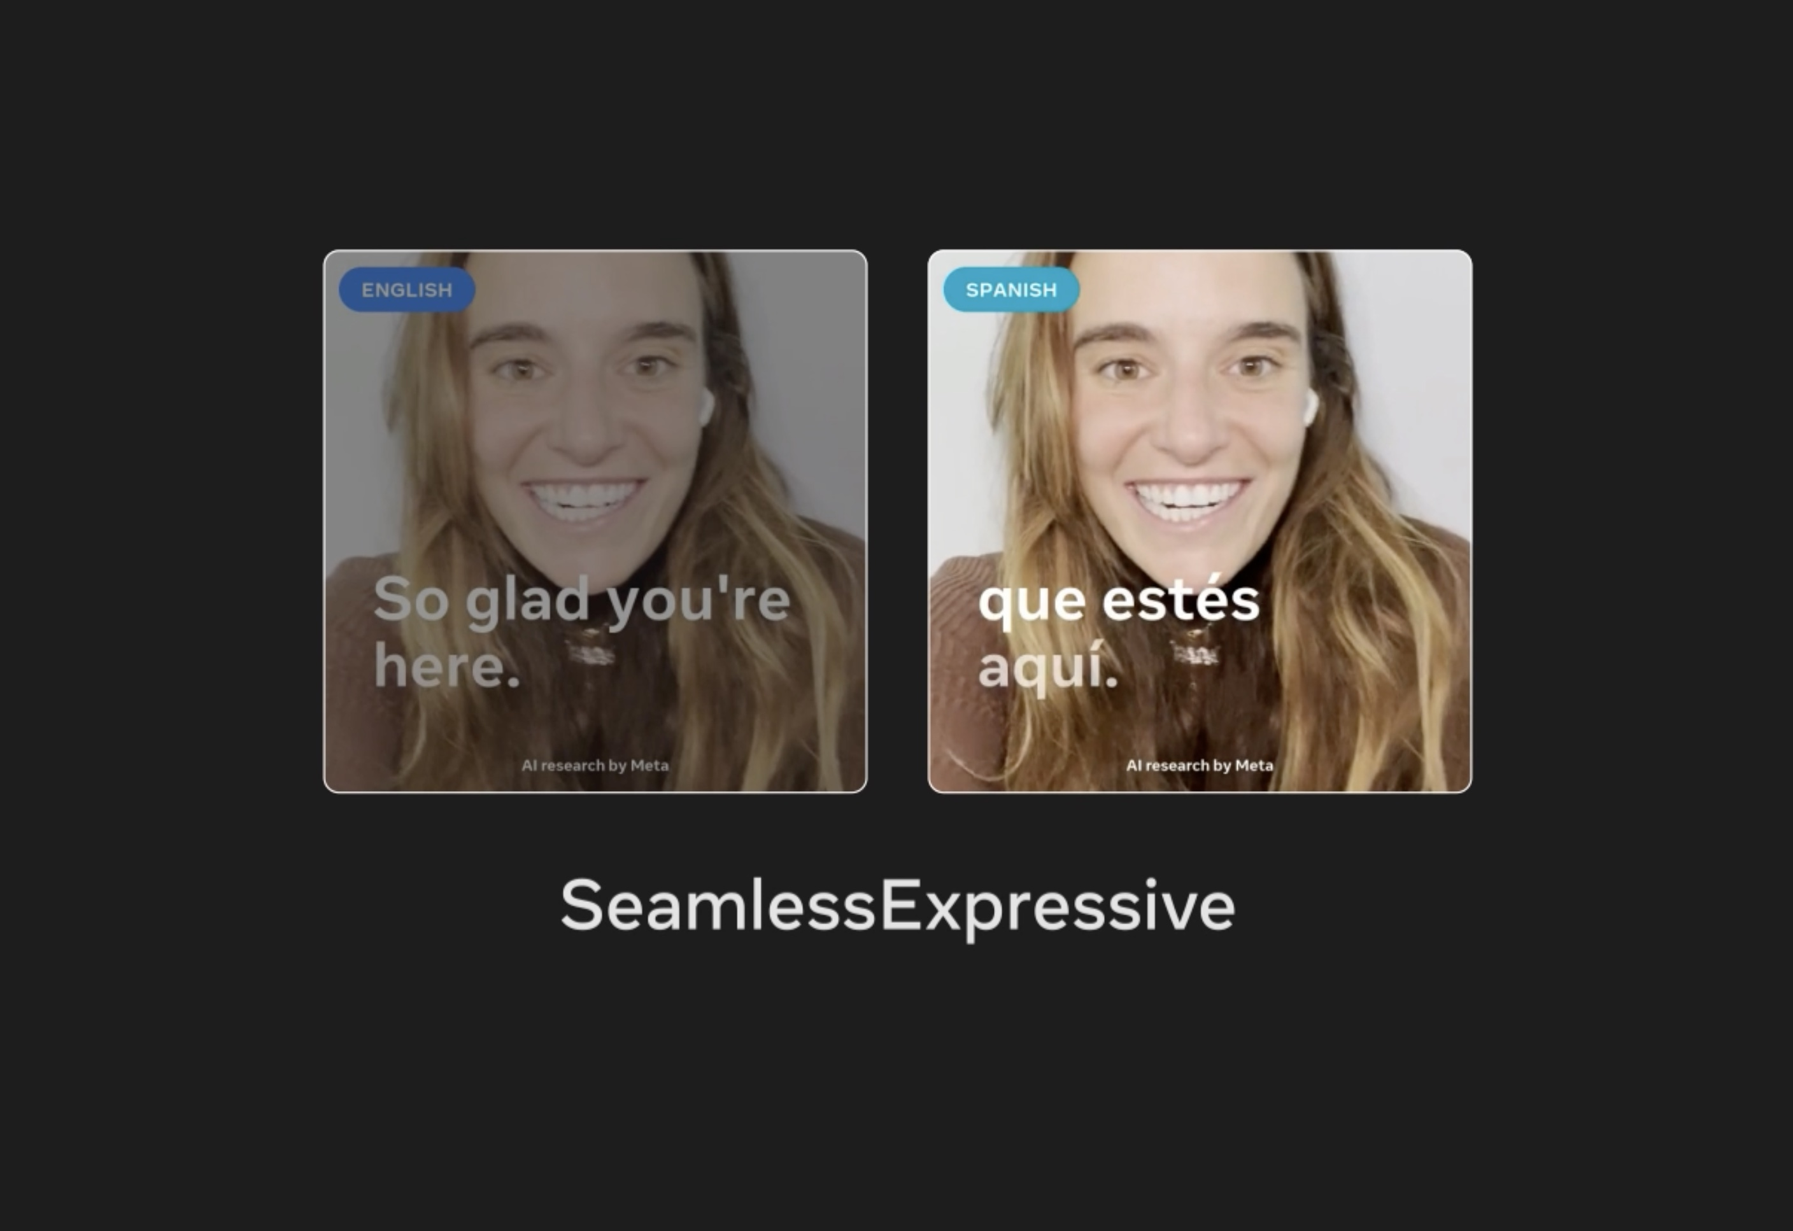
Use cases
Speech-to-text translation (e.g. YouTube does this)
Subtitling
  Speech translation + compression, optimizing line breaks, applying length constraints
Speech-to-speech translation
  Easiest: use a fixed voice for output
  More difficult: use a voice that is similar to the source voice (even in multi-speaker recordings)
  Most difficult: retain the expressivity (emotions, stress, prosody) of the source voice
Even more difficult: do all this in realtime

Slide 3
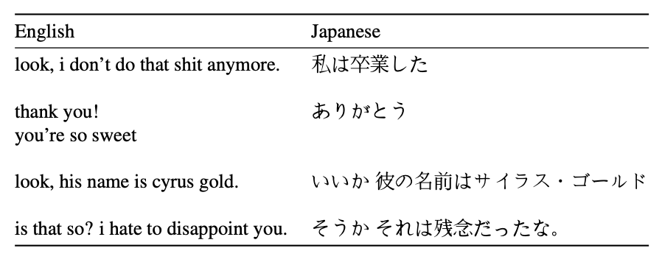
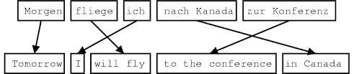
Text-to-text translation: history
Statistical machine translation
  Find parallel text corpus
  Align words (or phrases) with each other
    Can be done automatically, if corpus is big enough
  Extract translation units, with scores
    "fliege -> "will fly" 0.4
    "fliege" -> "am flying" 0.3
  Translation:
    Decompose source sentence into meaningful units (words or phrases)
    Map units to all possible output units
    Find the best output sentence, by combining translation scores with language model scores

Slide 4
Text-to-text translation: statistical model
Translating "väljas sajab" -> "it is raining outside" (simplified)
  Deconstruct: "väljas", "sajab"
    "väljas" -> "outside" 0.7
    "väljas" -> "in the field" 0.3
    "sajab" -> "raining" 0.5
    "sajab" -> "is raining" 0.3
    "sajab" -> "it is raining" 0.2
  Create all different combinations and permutations, compute translation and language model scores
    "Väljas" -> "outside", "sajab" -> "raining"
      outside raining P_{translation} = 0.7*0.5 P_{LM}=0.003
      raining outside P_{translation} = 0.7*0.5 P_{LM}=0.005
    "Väljas" -> "outside", "sajab" -> "is raining"
      outside is raining
      is raining outside
    …
  Select the output whose combined translation and language model score is the best

Slide 5
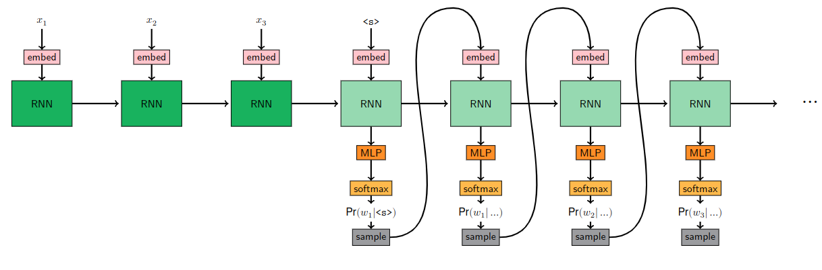
Neural machine translation (NMT)
Sequence-to-sequence
Has to compress the full source language meaning to a fixed-size vector that is fed from encoder to decoder

Slide 6
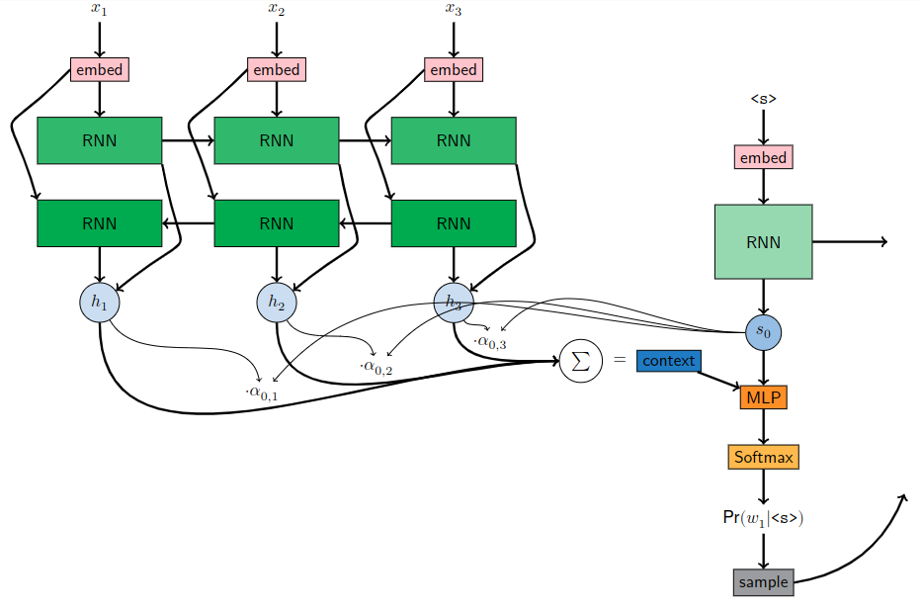
Seq-to-seq with attention
Encoder: bidirectional RNN
Decoder state s₀ is used to compute the query vector
Query vector is used to compute softmax over encoder states
Weighted average of encoder states: context vector
Decoder state and context vector are concatenated
The results is fed through a fully connected layer + softmax, to get the next output word

Slide 7
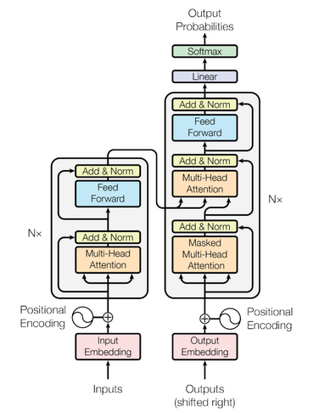
Transformer
As in most NLP tasks, the ruling method in MT is currently Transformer (enoder-decoder)
Decoder-only architectures (i.e., LLMs) are catching up
  "Translate to English: Väljas sajab vihma" -> "It is raining outside"

Slide 8
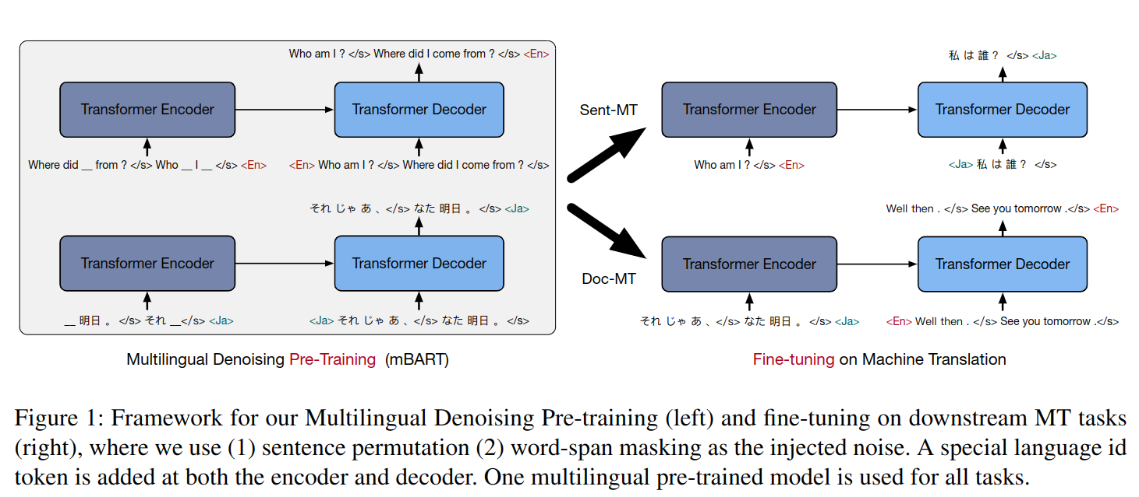
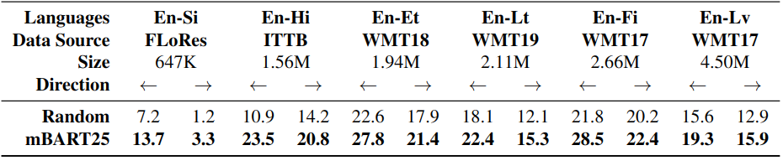
Some tricks: pretraining
Parallel translation data is usually scarce
Pretraining helps, e.g. mBART
  mBART is first pretrained on a denoising task, using multilingual data
    Each denoising sample is monolingual
  Pretrained model is then finetuned on translation data
Gives a nice improvement on low and medium resource language pairs

Slide 9
Some tricks: backtranslation
Parallel texts are hard to find
Back-translation (BT) is a method to exploit monolingual data for high quality MT
BT assumes that there is abundant monolingual data in the target language
Steps to improve Estonian->English MT system
  Train initial MT model on existing parallel data, but in the opposite direction (i.e.,
  English->Estonian)
  Use it to generate more parallel data
  Now train Estonian->English on original + synthetic data
  This can be repeated several times
Uses the fact that we target side data is more important for translation quality, and therefore uses authentic data for target size
The synthetic source side (created by MT) might be flawed, ungrammatical to some extent, but hopefully close to human language

Slide 10
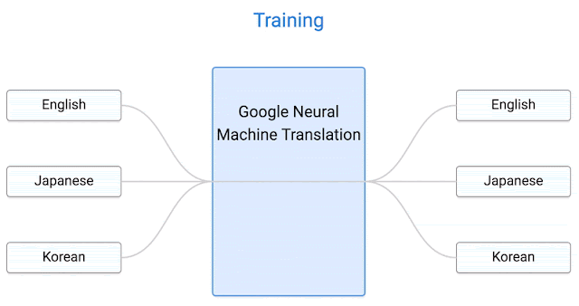
Multilingual MT
With encoder-decoder models, it is easy to build multilingual MT systems
  E.g., just use a target language tag is the 1st token in the decoder
Such models can perform zero-shot translation on language pairs whose parallel data is not present in the training corpus
  e.g. Korean-to-Japanese was not present in training data, but models learned it from other language pairs
This enables massively multilingual models (e.g. with 200 languages)
However, zero-shot quality is usually not very good (but better than nothing)

Slide 11
Evaluation
Evaluation is very important for MT, but also very complicated
  Every source sentence can have several "perfect" translations
  What to evaluate?
    Readability? Work needed to post-edit, in order to create publishable translation?
Manual evaluation
  What to show annotators when assessing a translation candidate?
    Ref-based: only the (human) reference
    Src-based: only the source sentence
    Src&ref-based: both
  Context to consider:
    Sentence-level: sentences of a document in random order
    Document-level: obtain a single score per document
    Document-aware: show whole document, asses per sentence (assumes sentence-per-sentence translation)
  What to ask:
    Some relative score over several candidates
    Some absolute score for a single candidate
    A more complicated question?

Slide 12
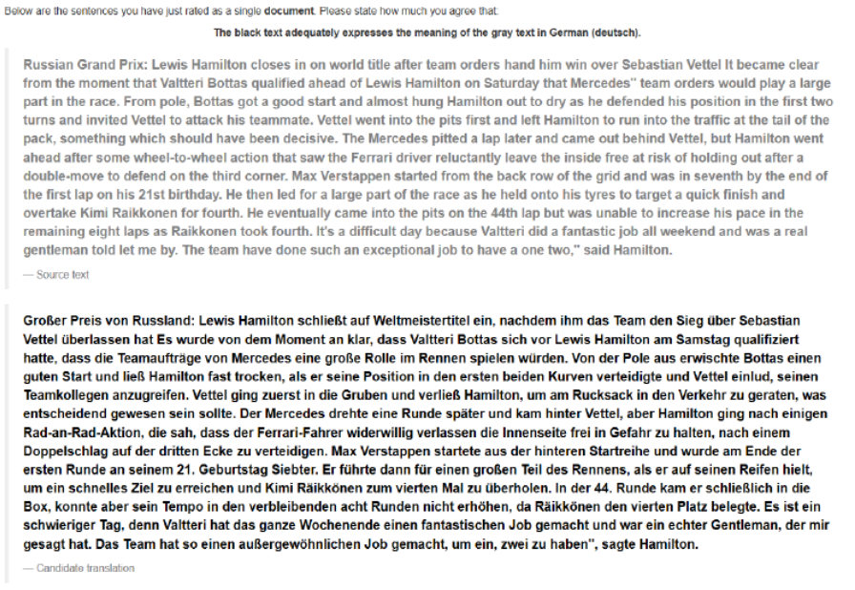
Some problem with manual annotation
Always time-consuming and expensive
Relative ranking of candidates: Longer sentences hard to rank. Candidates incomparably poor
Document-level manual assessment very hard, mental overload

Slide 13
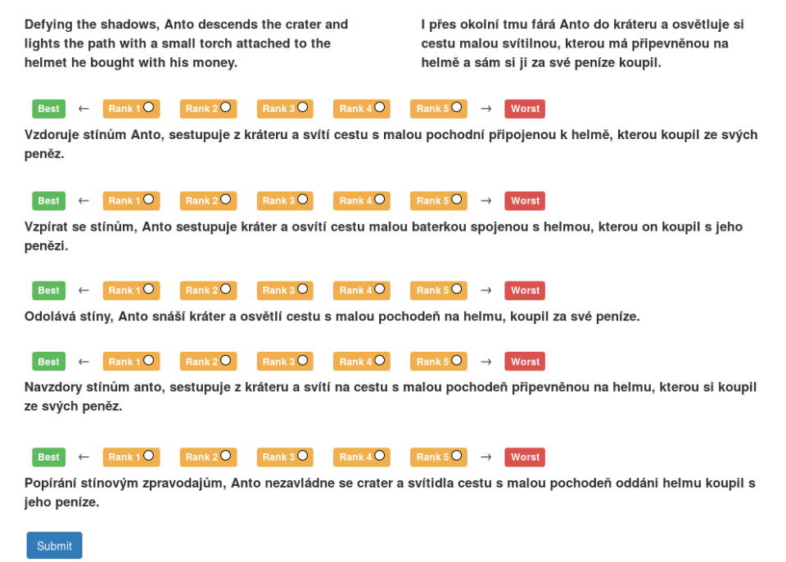
Manual relative ranking: example

Slide 14
Quiz-based evaluation
Given: text paragraph in source language
Create 3 quiz questions about it in the target language
Present human annotator:
  Machine-translated text
  Questions
Score how well the quiz is performed

Slide 15
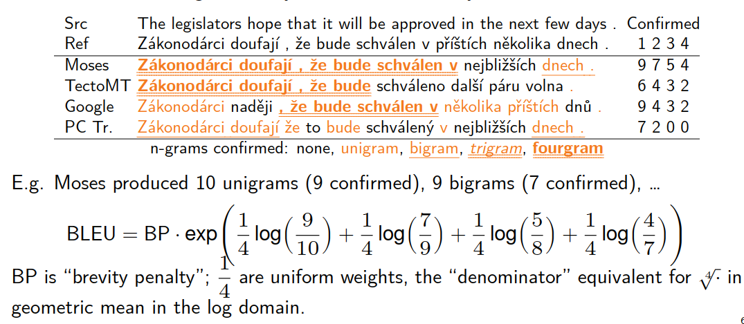
Automatic evaluation: BLEU
Based on geometric mean of 𝑛-gram precision.
  ≈ ratio of 1- to 4-grams of hypothesis confirmed by a ref. Translation

Slide 16
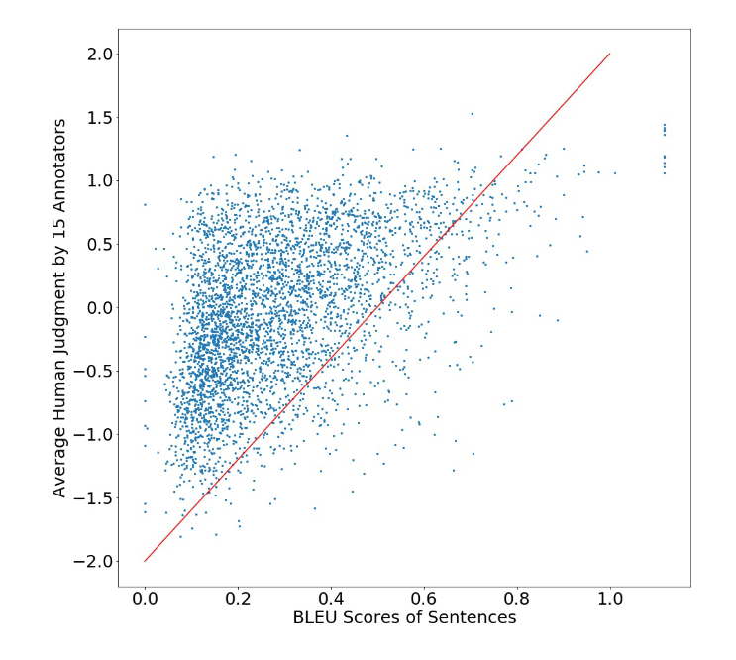
BLEU properties
BLEU is in the range of 0..1 (often written using %, 0..100%)
Human translation against other humans: ~60%
Google Chinese→English: ~30%, Arabic→English: ~50%
BLEU for individual sentences not reliable
Not always correlated with human judgements
BLEU scores are not comparable:
  across languages
  on different test sets
  with different number of reference translations

Slide 17
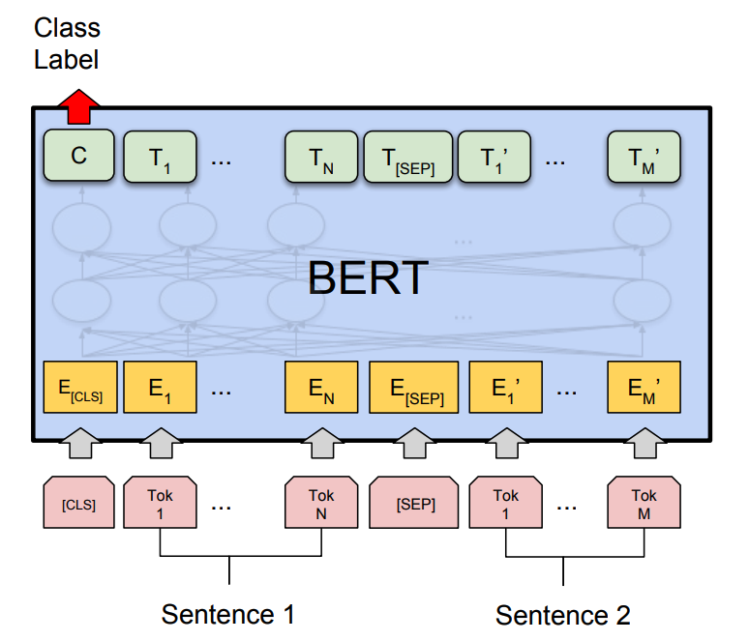
Automatic evaluation: BLEURT
BLEU doesn't cosider such things as synonyms at all
Yet we know that one sentence can have many "perfect" translations
BLEURT is a trainable multilingual metric
Multilingual BERT, finetuned for quality estimation
Input: reference and MT candidate, separated by the [SEP] token
Output: [CLS] -> 0..1
BLEURT goes through a few additional phases of training.
  The “pre-training” phase incorporates synthetic text from Wikipedia, which is randomly perturbed to mimic variations in output
  Finally trained on translation references + candidates and their human judgements (in several languages)

Slide 18
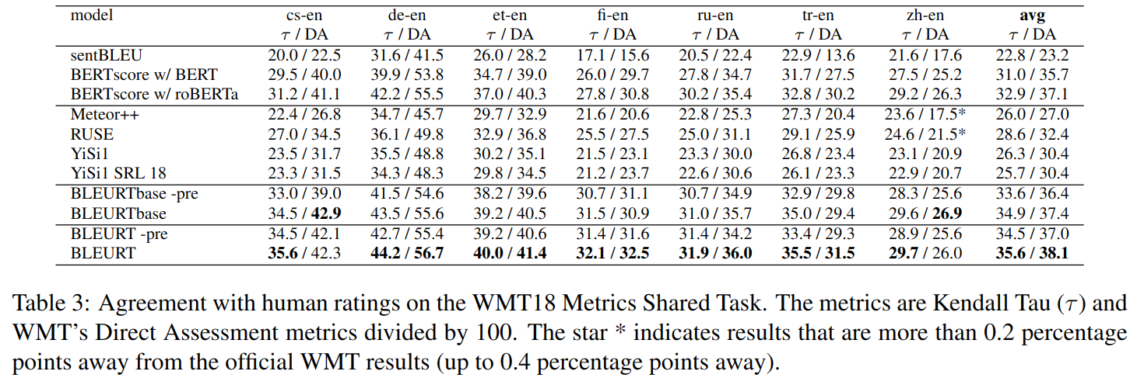
BLUERT: performance
BLUERT is better correlated with human judegments than BLEU and other metrics

Slide 19
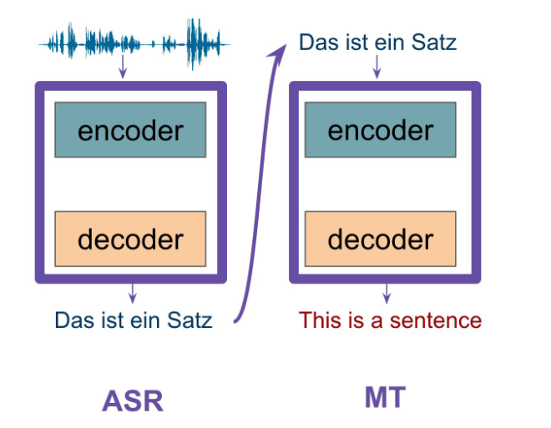
Speech translation: cascade
Simple: first do speech recognition (ASR), then MT, using decoupled models
  Usually also applies segmentation/diarization before ASR
Good:
  Training data availability
  can swap out ASR or MT systems and get improvement
Problem: error propagation
  Speech recognition errors could be amplified by MT
  (Partial) solutions:
    Present MT system n-best hyps from ASR
    Train MT on noisy source texts, to be robust against ASR errors
Also: cannot really use use speech->text training data (such as speech + translated subtitles) for training

Slide 20
End-to-end Speech translation: challenges
"Modeling burden"
  A single model has to learn both meaningful speech representations (such as phonemes and words) and translation
  Harder task than ASR, since in ASR there is usually a monothonic alignment between speech and text
Data scarcity
  Very few real speech translation corpora availble, while large ASR and MT datasets are more abundant
Result: almost impossible to train "pure" E2E speech translation models from scratch only on speech translation data

Slide 21
Using synthetic data
ASR and MT data is often available
Can create two types of synthetic data:
  Use MT to translate ASR training data to target language
  Use text-to-speech to synthesize audio for source language side ot MT training data
Problems:
  Using MT to translate ASR training data puts a "cap" on achievable speech translation quality. Also, cannot take into account prosody, stress, etc.
  Synthesized speech may lack naturalness, spontaneosness and speaker variability

Slide 22
Pretraining and sharing parts of E2E model
Most state-of-the art speech translation models make smart use of additonal data or models
Pretraining: train parts of the model beforehand
Multi-task learning: train a more complex model to perform more tasks (e.g., speech recognition or machine translation)

Slide 23
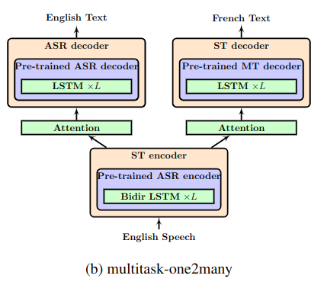
Multi-task learning: one-to-many
Weis et al 2017
  One encoder
    Source language audio
  Two decoders
    Source language text
    Target language text
  Train on both AST and ST data
If source language text is available for speech translation data, then we can use CTC to co-train encoder for doing ASR

Slide 24
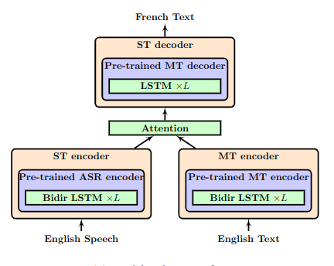
Multi-task learning: many-to-one
Train on 2 tasks:
  Text-to-text translation
  Speech-to-text translation
2 encoders, 1 decoder
Speech encoder applies so-called adaptors (typically just strided convolution) in the last layers to make the frame rate of speech comparable to token rate of text

Slide 25
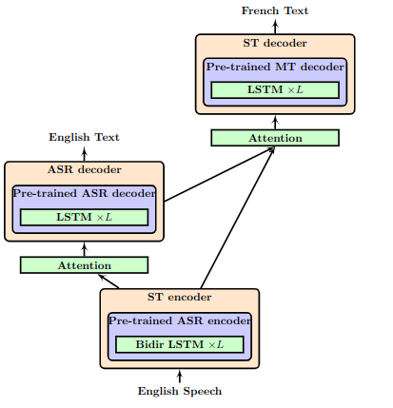
Multitask learning: triangle
Speech recognition and speech translation are trained simultaneously
Target language decoder attends over encoder outputs as well as decoder outputs
Requires ST data with source language transcription

Slide 26
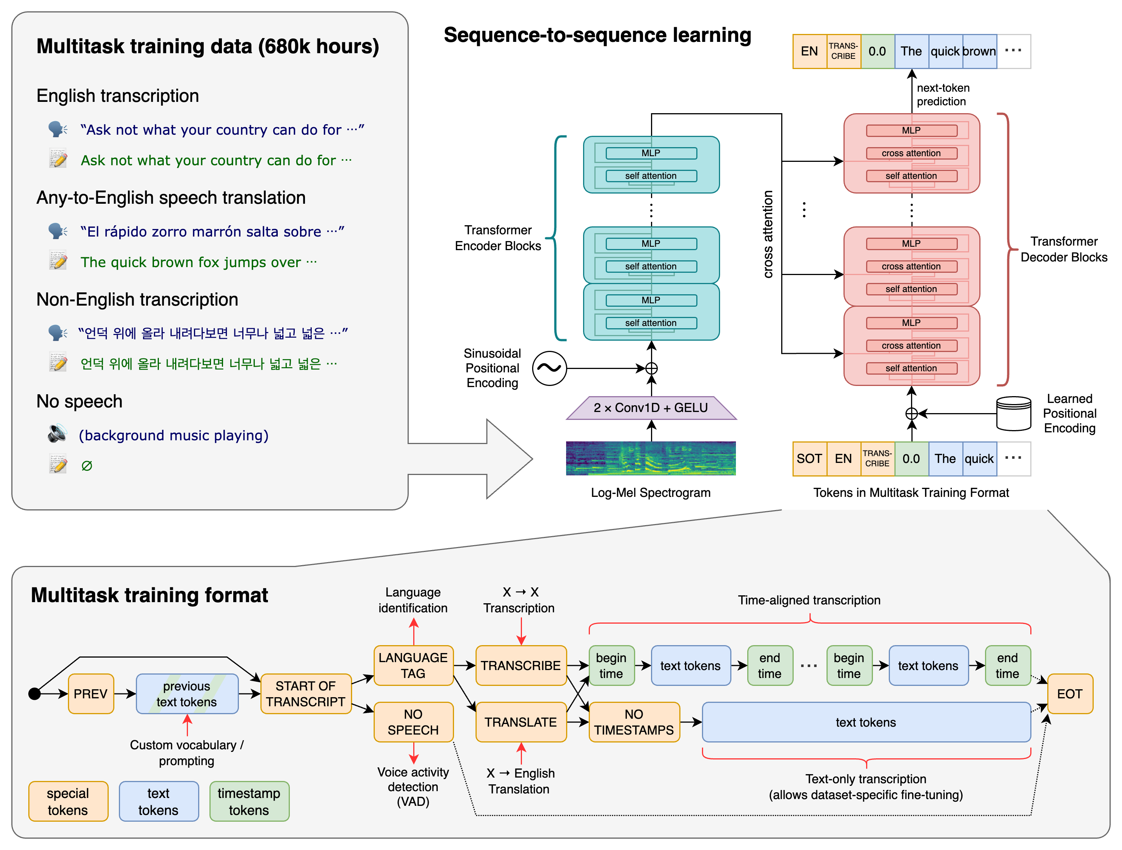
Multi-task learning: single encoder&decoder
Like Whisper model
Use a single encoder and decoder, but use a special token prefix to denote the task (transcribe or translate)
Benefit over 2-decoder approach: decoder can benefit from ASR data in the target language
E.g., to train Estonian->Latvian system, use the following data:
  Estonian and Latvian ASR data
  Estonian-to-Latvian speech translation data

Slide 27
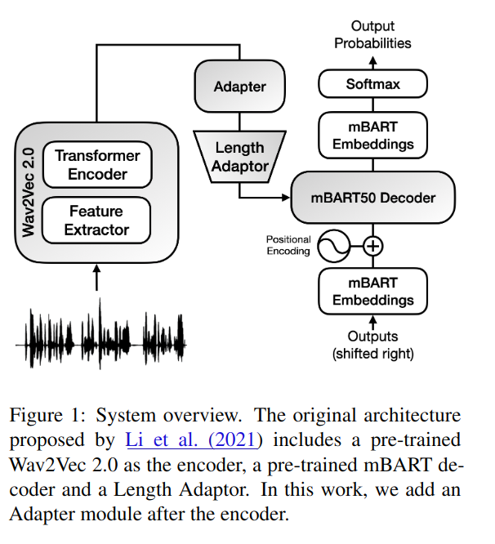
Pretraining: using unlabelled data
We usually have abundant unlabelled training data:
  Source language speech
  Target language text
Let's pretrain two models and bridge them!
  Wav2vec2.0 on source language speech
    Or, just use a multilingual wav2vec2.0 -- might work as well and is readily available!
  BART -- text-based encoder-decoder model trained to denoise artificially scrambled text
    Or, just use the multingual mBART, unless the target language is very exotic
If source-to-target language MT data is available, pre-finetune BART for text-based MT
Length adaptor is used to reduce the output frame rate of speech encoder
This approach is perfected by Meta's Seamless4MT model

Slide 28
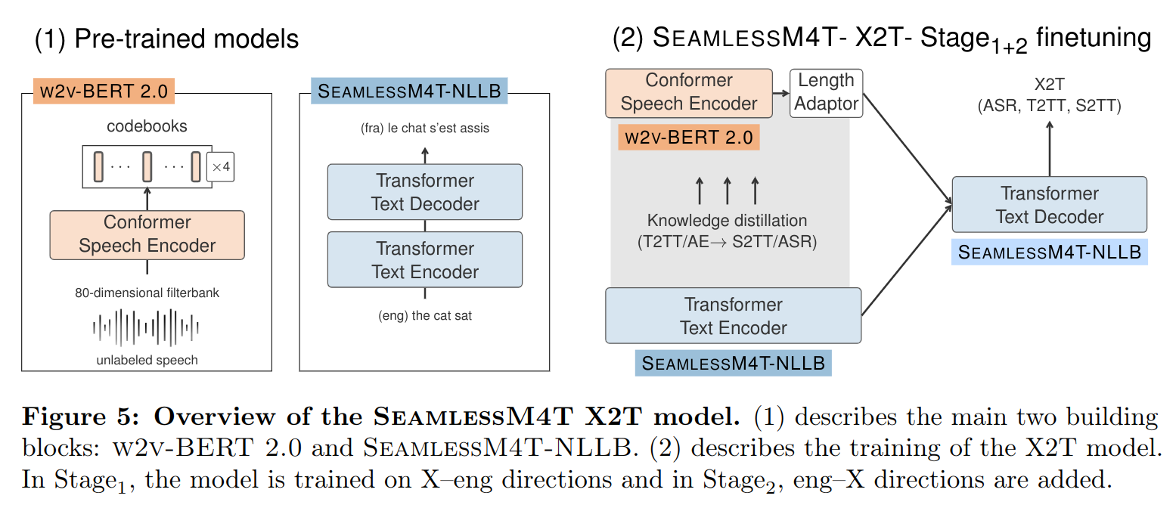
Seamless4MT: more details
Starts with 2 models:
  w2v-BERT 2.0: improved wav2vec20 model, trained on 1 million hours of open speech audio data that covers over 143 languages
  Seamless4MT-NLLB text-to-text translation model: massive transformer-based MT model trained on 200 languages

Slide 29
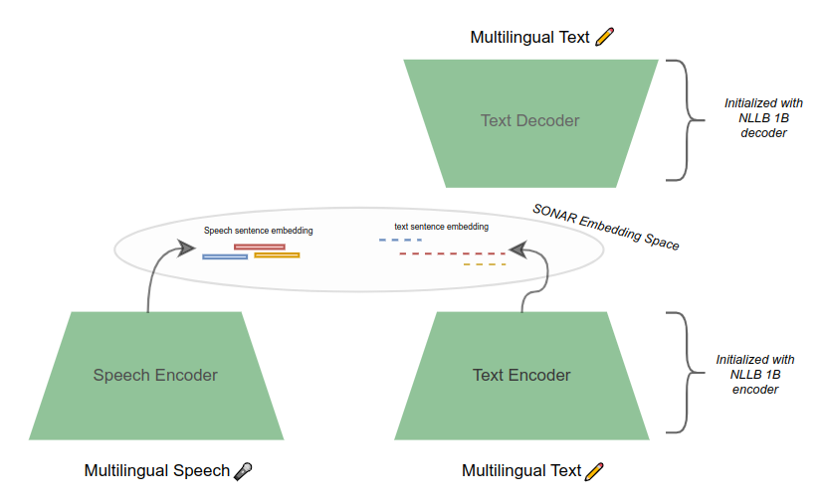
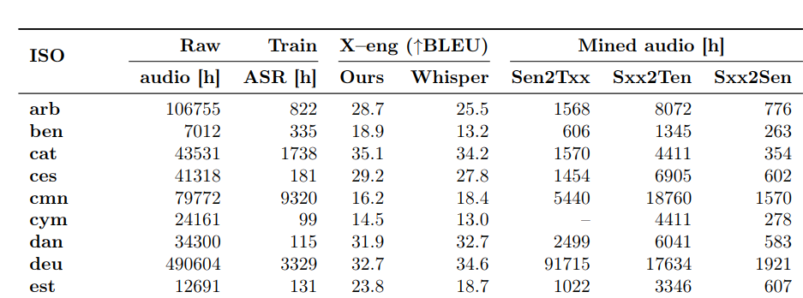
Seamless4MT: speech and text data mining
Starts with some initial amount of speech and corresponding text data
This is used to train so-called SONAR embedding model
  SONAR can map multilingual speech and text to a joint embedding space
  If a speech segment (in Estonian) and the corresponding text (in English) map to close embeddings, then the English text is likely a translation
SONAR is then used to mine for parallel speech-text data from the internet
The resulting dataset is used to train the final model

Slide 30
Some recent results on Estonian speech translation to English & Russian
BLEU scores. Data: TV news, talkshows, press conferences
Model | Estonian-to-English | Estonian-to-Russian
Estonian ref transcripts -> Google Translate | 38.9 | 26.1
Estonian ref transcripts -> UTartu MT | 34.8 | 29.3
Whisper-large-v3 | 14.9 | -
SeamlessM4T v2 | 13.2 | 16.2
Cascade: Estonian ASR -> Google Translate | 34.7 | 23.4
SeamlessM4T v2, finetuned on found internet data (Estonian speech with English and Russian subtitles) | 19.3 | 14.4
SeamlessM4T v2, finetuned on synth data (Estonian ASR data, translated using MT) | 35.4 | 26.8
Whisper-large-v3, finetuned on synth data (Estonian ASR data, translated using MT) | 33.2 | 26.1

Slide 31

Demo
Automatic translation (whisper-large-v3 model):
Good afternoon, dear viewers here in Tallinn's press conference, all of you who are watching us.
The webinar will be held on December 16th.
Tallinn City Council has held its inaugural meeting and today the City Council press conference will be attended by the mayor Mihail Kõlvart.
The director of communication in Tallinn from January 1, 2021, Keesti Ruul.
Our good friend from Tervisaameti, the head of the epidemiology department, Riina Tantsenko.
And Kaisa Kamm, the director of emergency care in Estonia.
And we have already heard and read the news today that there were 590 positive cases in the evening.
And that's why the Tervisaameti epidemiology department head, Riina Tantsenko, also starts today.

Slide 32
Demo
Automatic translation. Whisper, finetuned on synth data (Estonian ASR data, translated using MT):
Good day, dear journalists here at the Tallinn presentation and in the press center, all interested are watching us via online transmission, it is the sixteenth of December.
The Tallinn city government has held its regular session, and today the mayor Mihhail Kõlvart is in front of you at the city government's press conference.
The director of city communication from the first of January, two thousand and twenty one, Kersti Ruu, our good acquaintance from the Board of Health, Irina Tontšenko, adviser to the Epidemic Control Department, and Kaisa Kamm, head of direct assistance of the Estonian Animal Protection Society.
And we have already heard and read the news today that five hundred and ninety corona positives were added in a day.
And that's why Irina Tontšenko, adviser to the Epidemic Control Department of the Board of Health, starts today as well.

Slide 33
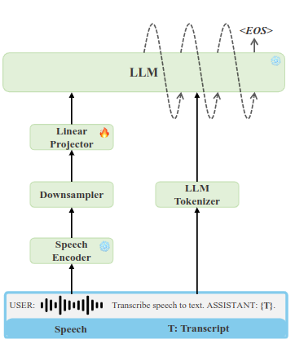
Future: Speech + LLMs
Very recent works have shown that LLMs can be effectively used for speech processing, including end-to-end ASR, speech translation
Very strong results
How?
  Use pretrained instruction-tuned LLM
  And a speech encoder, e.g encoder part of Whisper-like model, or a wav2vec2 model
  Downsample speech features
  Train a projection layer that maps speech "tokens" to the same semantic space as text tokens

Slide 34
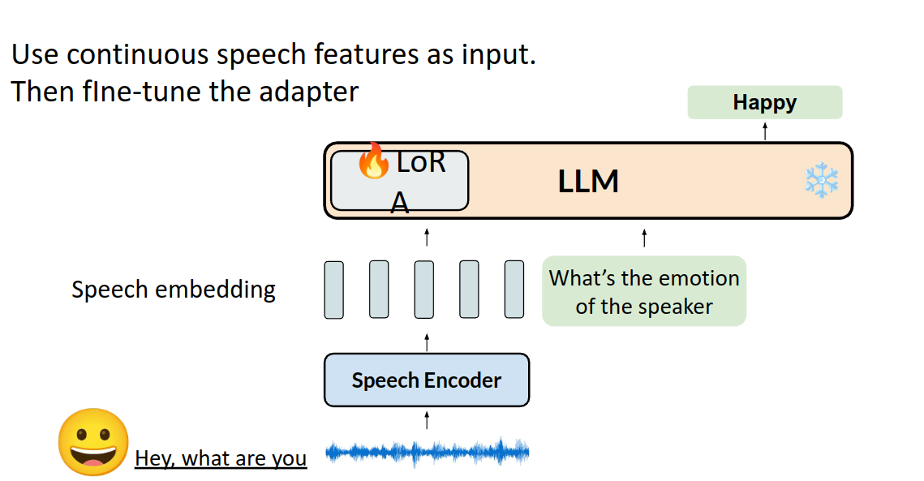
Speech features to LLM
Speech features typically use a much higher frame rate, like 50-100 per second
Typical read speech is only ~2 text tokens per second!
Solution: downsample speech features, and train a mapping to LLM token space
Optionally, also finetune the LLM

Slide 35
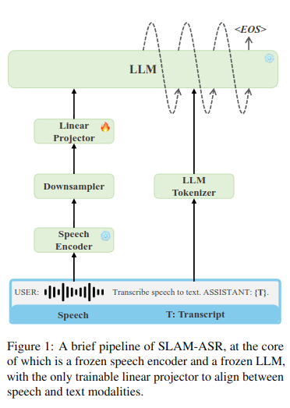
Slam-ASR:
"An Embarrassingly Simple Approach for LLM with Strong ASR Capacity", Feb 2024
Speech encoder: encoder module from OpenAI Whisper, or self-supervised encoder (like wav2vec), finetuned for speech recognition
Downsampler: concatenate every 5 features, leading to 10 "superfeatures" per second
Linear projector: simple feed-forward neural network with one hidden layer (dim=2048)
LLM and speech encoder are pretrained
Linear projector is the only trainable module!

Slide 36
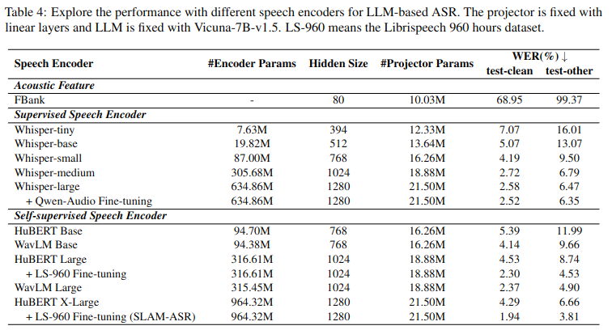
Slam-ASR: results
Best results when using self-supervised model (HuBERT) as encoder, finetuned for ASR

Slide 37
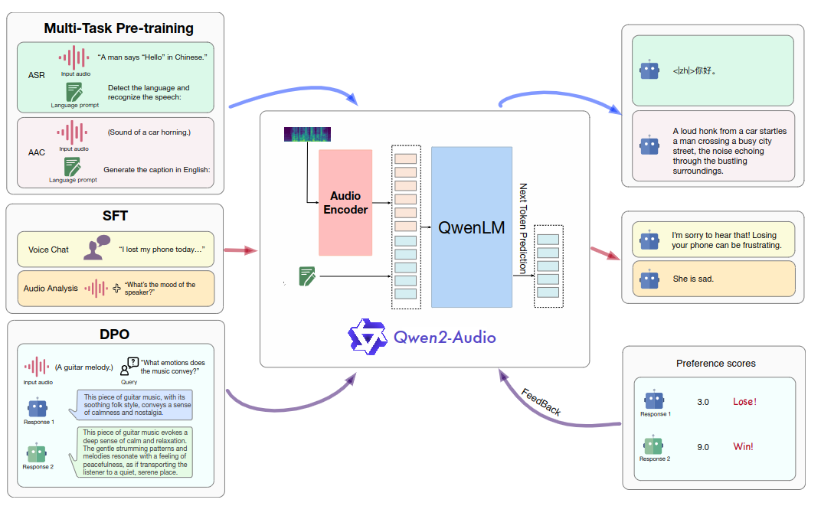
Qwen2-Audio: chat using audio
Qwen2 from Alibaba as LLM
Audio encoder from Whisper

Slide 38
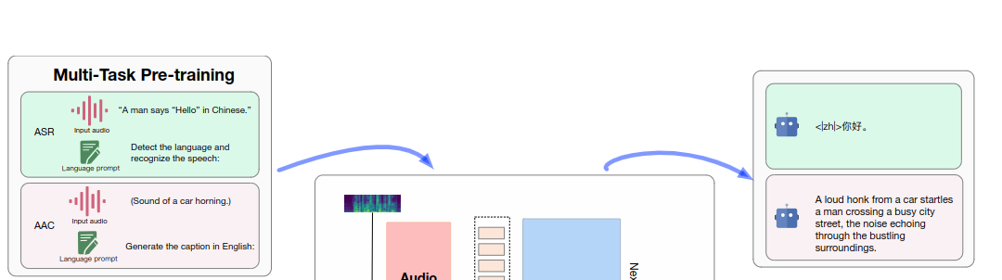
Qwen2-Audio, cont.
Pretraining phase: use ASR, speech translation, emotion recognition, audio captioning datasets to do large-scale pretraining

Slide 39
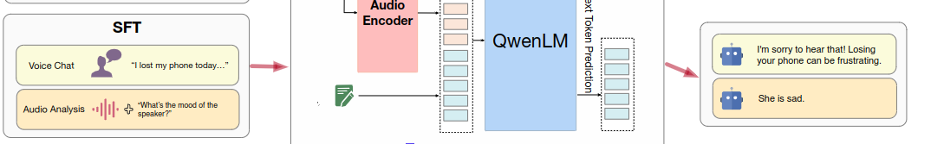
Qwen2-Audio, cont.
Supervised finetuning phase: use annotators to generate new training data
Two distinct modes for human interactions:
  Audio Analysis: In the audio analysis mode, annotators are asked to use Qwen2-Audio analyze a diverse array of audio. User instructions can be given either through audio or text.
    This mode is often used for offline analysis of audio files.
  Voice Chat: In the voice chat mode, users are encouraged to engage in voice conversations with Qwen2-Audio, asking a wide range of questions. "Please feel free to consider it your voice chat assistant."

Slide 40
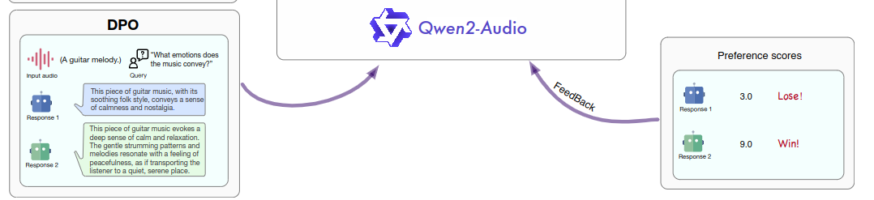
Qwen2-Audio, cont.
DPO phase: further optimizes models to follow human preferences.

Slide 41
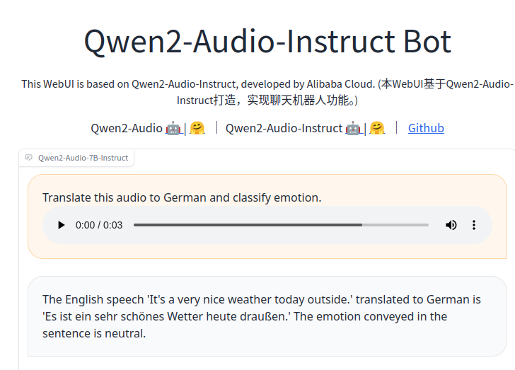
Qwen2-Audio, cont.
https://huggingface.co/spaces/Qwen/Qwen2-Audio-Instruct-Demo

Slide 42
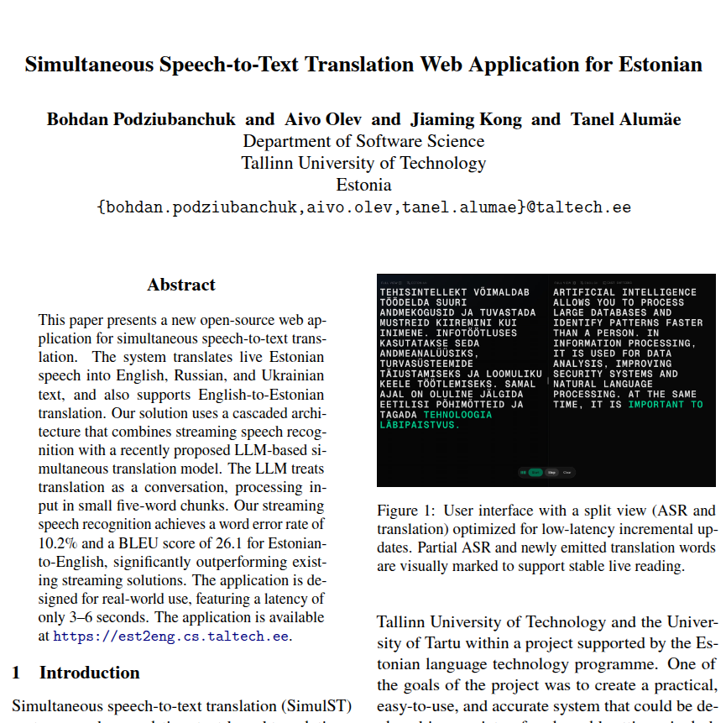
Demo: Estonian-to-English (almost) synchronous speech translation
https://est2eng.cs.taltech.ee/
Cascade architecture:
  Streaming speech recognition
  Chunks of 5 words translated by a specially finetuned LLM (with previous context)

Slide 43
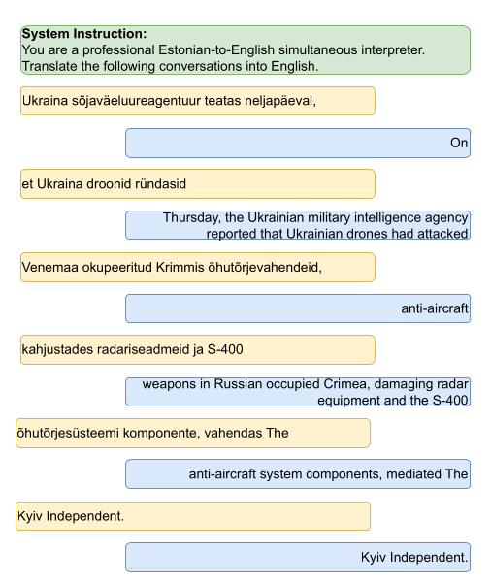
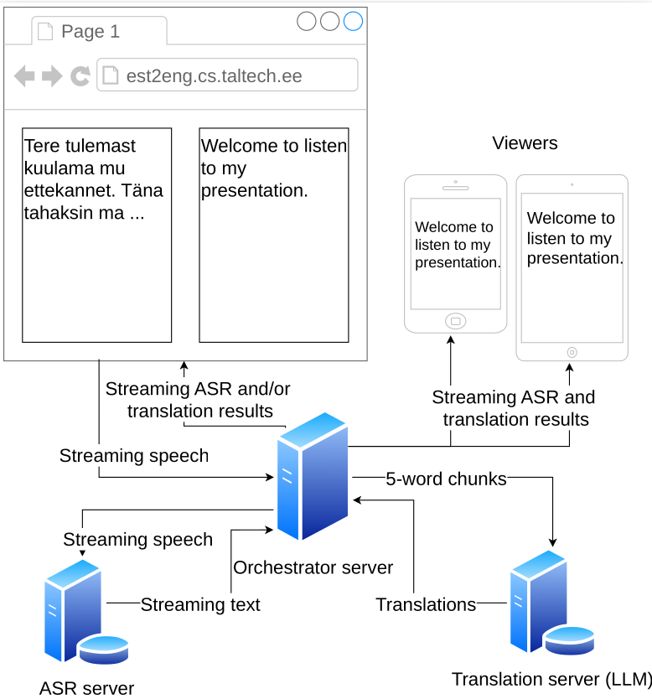
Est2Eng architecture

Slide 44
Conclusion
Speech translation is one of the "holy grails" of NLP
Future: emotion-preserving, voice-preserving simultaneous speech-to-speech translation (like movie dubbing)

