Slide 1
Foundation models in speech recognition
Part 1: Speech recognition basics
Tanel Alumäe
Laboratory of Language Technology
Tallinn University of Technology

Slide 2
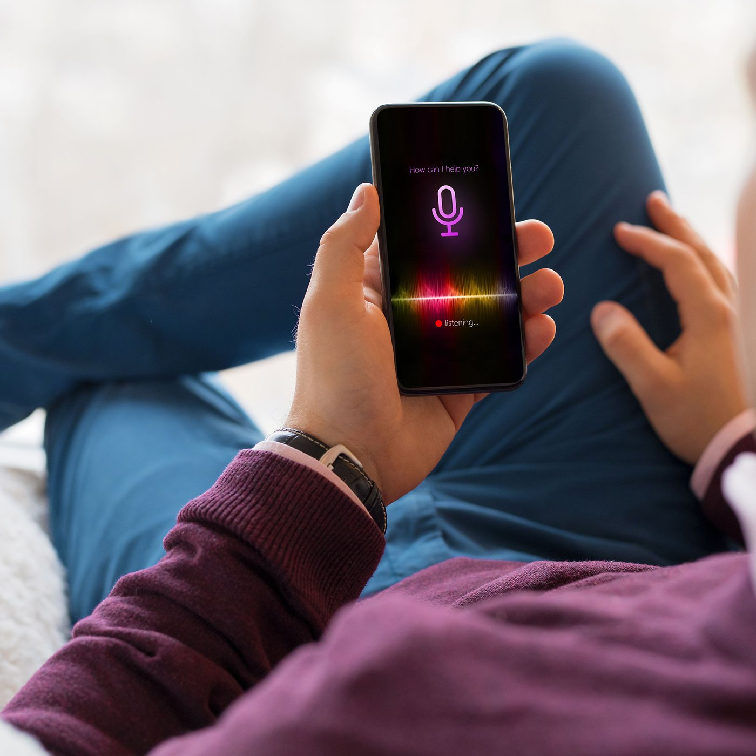
What is speech recognition?
Speech recognition is a technology that converts speech to text
  It doesn’t handle anything else, like speech (text) understanding
  Common misconception is that speech recognition = speech understanding
Applications:
  Dictation
  Transcribing meetings, lectures, videos, telephone calls
  A component in human-computer interaction systems
    Google Assistant, Siri, etc
    Amazon Echo, Google Home, etc
A component in speech-to-speech translation systems

Slide 3
Why is speech recognition difficult?
There are many different words (many are very similar), especially in morphologically complex languages (like Estonian)
  kast, kass, kasti, kas, kastid
The vocabulary is highly dependent on the domain
  E.g., Estonian radiology domain:
    Nimmelordoos on säilinud; täheldatav on vähene sinistroskolioos; spondülolisteesi ei ilmne.
Most importantly, there is a lot of variability in speech

Slide 4

Sources of variability
Speaker physiology
  Gender, shape of the vocal apparatus
  Physiological state, health, smoking
Speaking style and spontaneous speech
  In spontaneous casual speech, or under time pressure, reduction of pronunciations of certain phonemes often happens
  Rate of speech
  Lombard effect (the involuntary tendency of speakers to increase their vocal effort when speaking in loud noise)
  Emotions, stressing of certain words
Environment
  Reverberations, background noise
Channel
  Microphone, electronic noise, distortions
Coarticulation
  Same speech sound (phoneme, like "m") can sound very different in various contexts ("cumin" vs "calm")
Foreign and regional accents
  Non-native speakers can replace an unfamiliar phoneme in the target language with the sound considered as the closest in their native language phoneme inventory

Slide 5
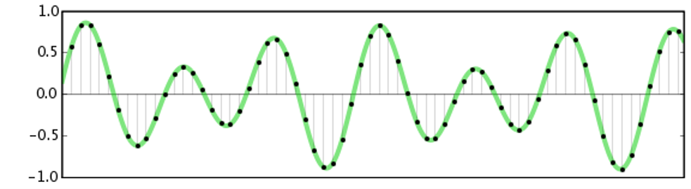
Speech signal
Sound is a waveform of changing air pressure
Speech is a sound produced by speech organs
Microphone converts air pressure modulation to voltage modulation
Analog-to-digital converter converts the continuous signal to digital signal, by sampling the value of the signal after perioding intervals
Sampling frequency (samples per second):
  Telephone: 8000 Hz
  CD: 44100 Hz
  For speech, 16000 Hz is usually sufficient

Slide 6
Feature extraction
Raw audio signal contains a lot of information (typically 16000 values every second)
The goal of feature extraction:
  Reduce the amount of information
  Extract information that is important for distinguishing between speech sounds
  Be robust against noise, channel distortions, speaker variation

Slide 7
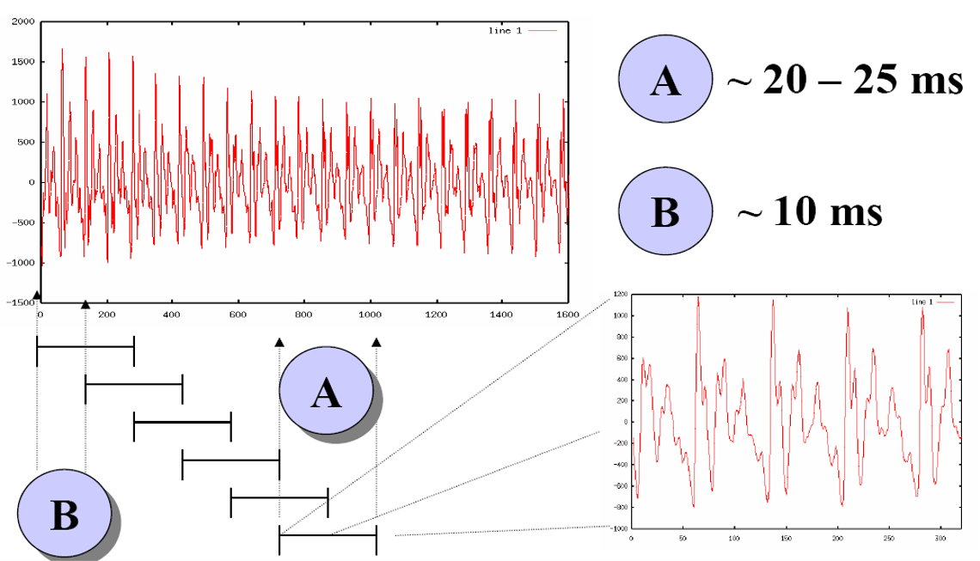
Splitting the signal into frames

Slide 8
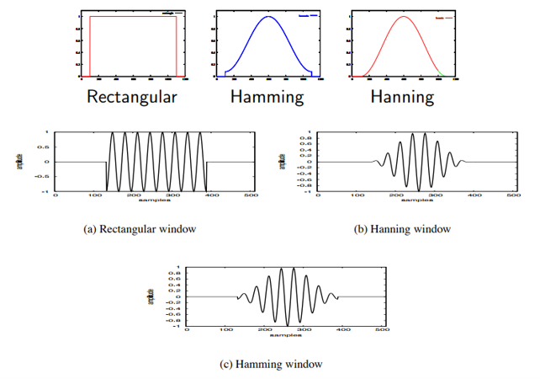
Windowing
After slicing the signal into frames, we apply a window function such as the Hamming window to each frame
Why?
  To counteract the assumption made by the FFT that the data is infinite and to reduce spectral leakage

Slide 9
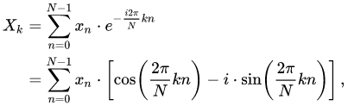
Discrete Fourier Transform
Purpose: extracts spectral information from a windowed signal
  i.e, takes an audio signal (like a speech) and breaks it down into its individual frequencies
This is motivated by the human cochlea (an organ in the ear) which vibrates at different spots depending on the frequency of the incoming sounds.
Input: windowed signal x[0], . . . , x[L−1] (time domain)
Output: a complex number X[k] for each of N frequency bands representing magnitude and phase for the kth frequency component (frequency domain)

Slide 10
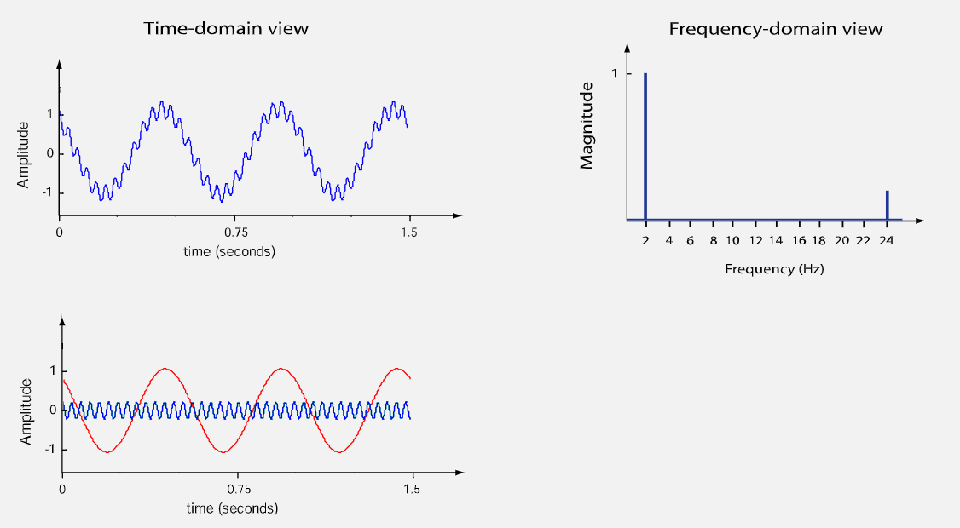
All signals can be decomposed into sinusoids

Slide 11
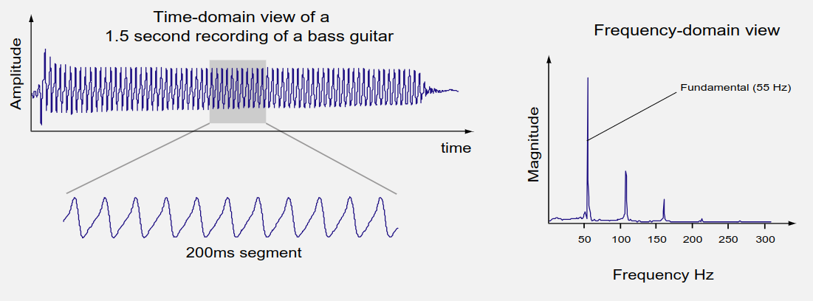
DFT, cont.
The frequency-domain representation of a signal is a convenient way of showing the oscillation rate associated with a signal

Slide 12
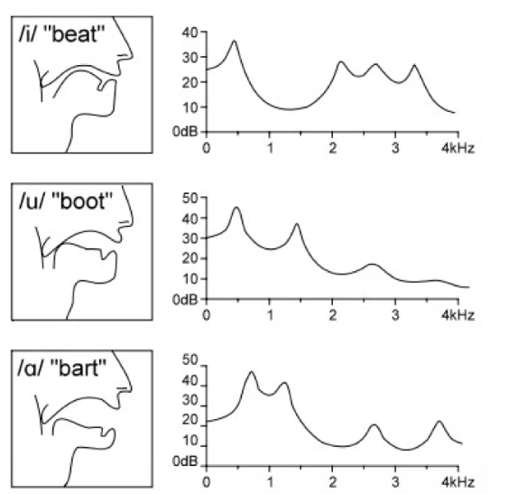
DFT spectrum

Slide 13
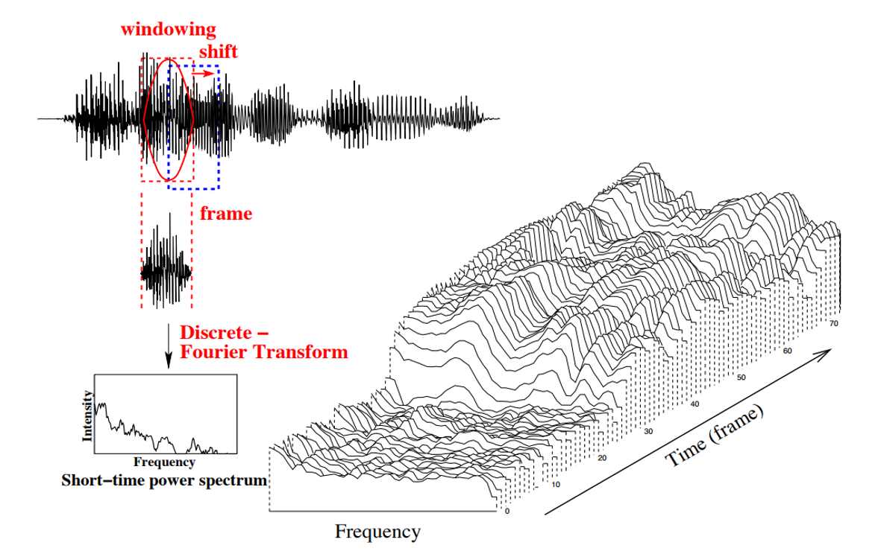
Short-time spectral analysis

Slide 14
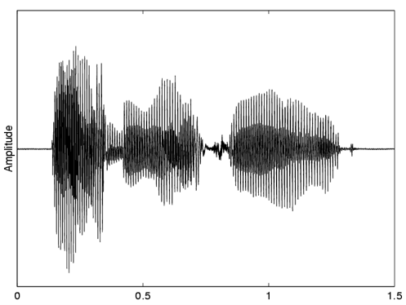
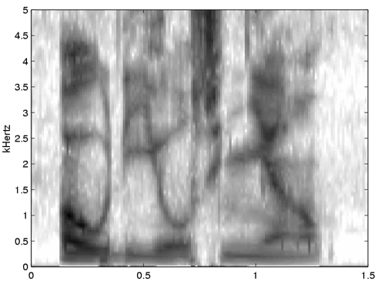
Spectrogram
If we turn the spectrogram 90 degrees up,
represent the values using grayscale,
and concatenate the spectrums of all frames
Then we will get a spectrogram
There are people (phoneticians) who can „read” the spectrogram, i.e., roughly understand what was said

Slide 15
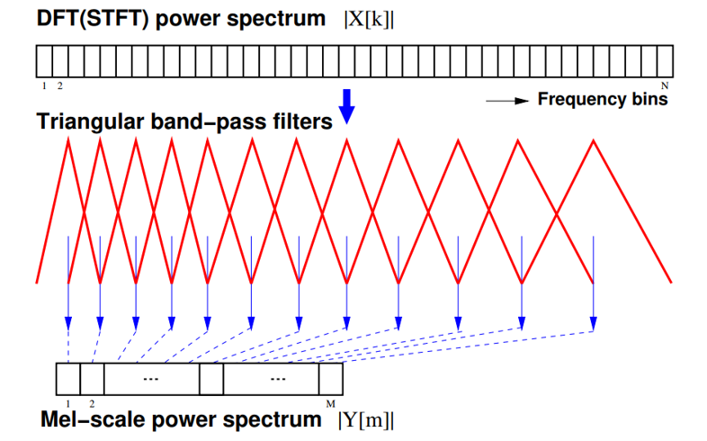
Filterbanks
Human hearing is less sensitive to higher frequencies — thus human perception of frequency is nonlinear
Also, spectrogram contains still too much information
That’s why mel-scale filterbanks are used to discretize the spectorgram
Mel-scale: use narrower bands in lower frequencies and wider bands in upper frequencies
Each filter collects energy from a number of frequency bands in the DFT

Slide 16

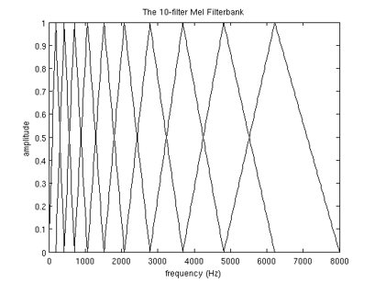
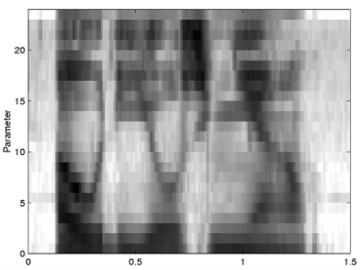
Log Mel Power Spectrum
Compute the log magnitude squared of each mel-filter bank output: log |Y [m]|²
  Taking the log compresses the dynamic range
  Human sensitivity to signal energy is logarithmic — i.e. humans are less sensitive to small changes in energy at high energy than small changes at low energy
  Log makes features less variable to acoustic coupling variations

Slide 17
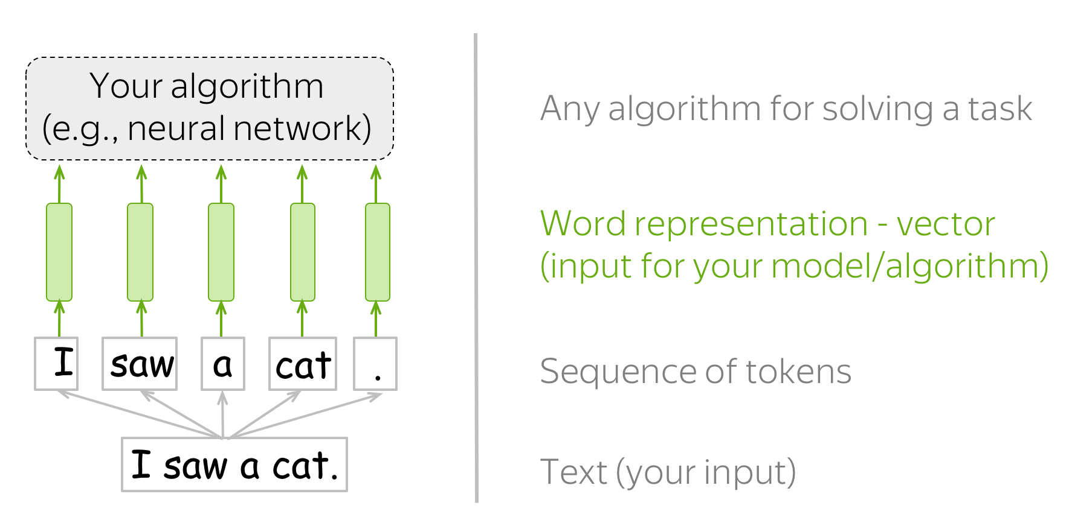
Resulting features
Filterbank features
  Short-time DFT analysis
  Mel-filter bank
  Log magnitude squared
Widely used for all kind of speech processing tasks
Result: a speech signal (e.g., for an utterance) is transformed into a sequence of fixed dimensional feature vectors
  The length of the sequence varies (based on the length of the input utterance)
This representation is similar to document representation using word embeddings!
Many familiar models (convolutional neural nets, LSTMs, transformers) can be also applied for speech!

Slide 18
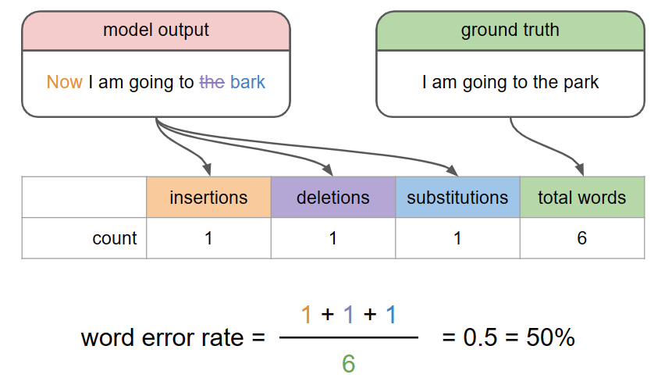
Speech recognition: metrics
The most common quality metrics for speech recognition is word error rate (WER)
Distinguishes between 3 types of errors:
  Insertion (I)
  Deletion (D)
  Substitution (S)
To find the errors, reference and hypothesis texts are aligned, using a technique called dynamic programming
WER=(S+D+I)/N , where N is the number of words in the reference

Slide 19
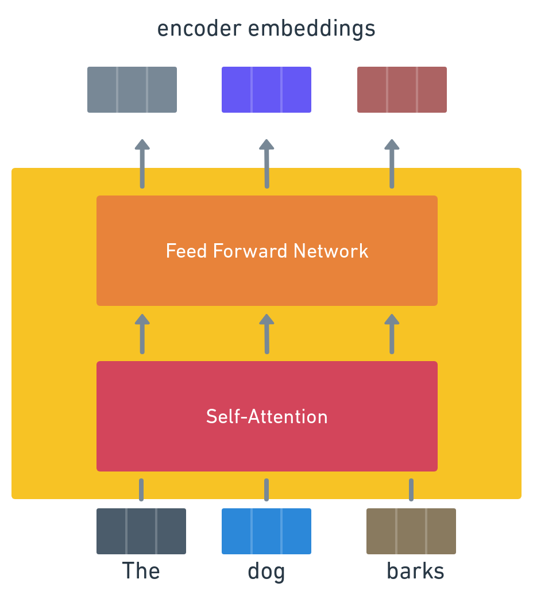
Some background: Transformer
Transformer is a neural network architecture for processing sequences of vectors
  Each input vector is transformed to an output vector
  For transforming an input vector, information about all other vectors in the sequence can be used
  This is done using several layers of self-attention layers
  Transformer is trained to perform the most optimal transformation with regard to the task and training adata

Slide 20
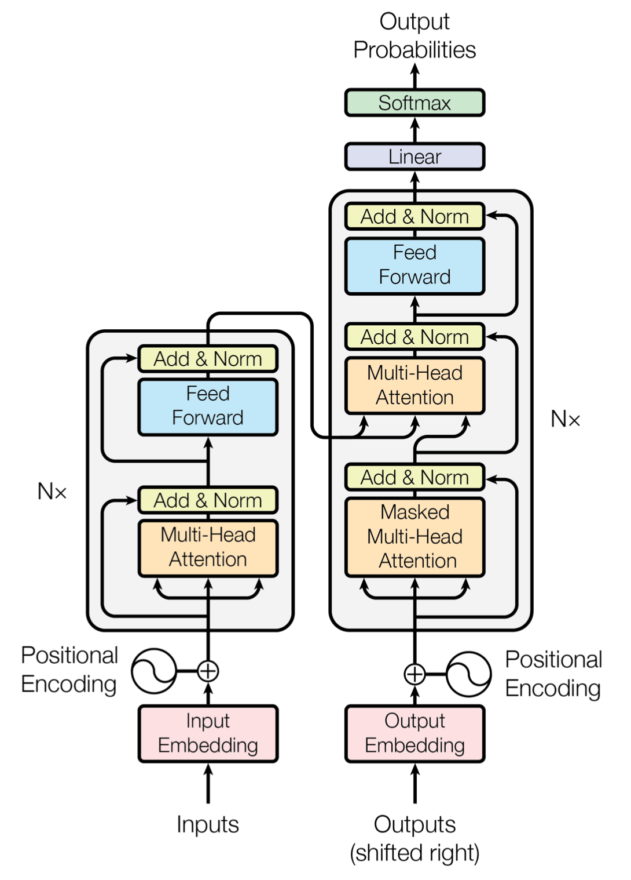
Some background: Three types of Transformers
Encoder:
  Whole sequence is processed at once
  Tasks: word classification, text classification, extractive question answering
Decoder:
  Only past words are used for processing the ith word
  Can be used for generating text
  Tasks: generating text with large language models (LLMs)
Encoder-decoder:
  Input sequence is processed "offline", and the output sequence is processed token-by-token, using decoder that looks at the encoder's output and the already generated output
  Can be used for generating text (given the input)
  Tasks: machine translation, speech recognition

Slide 21
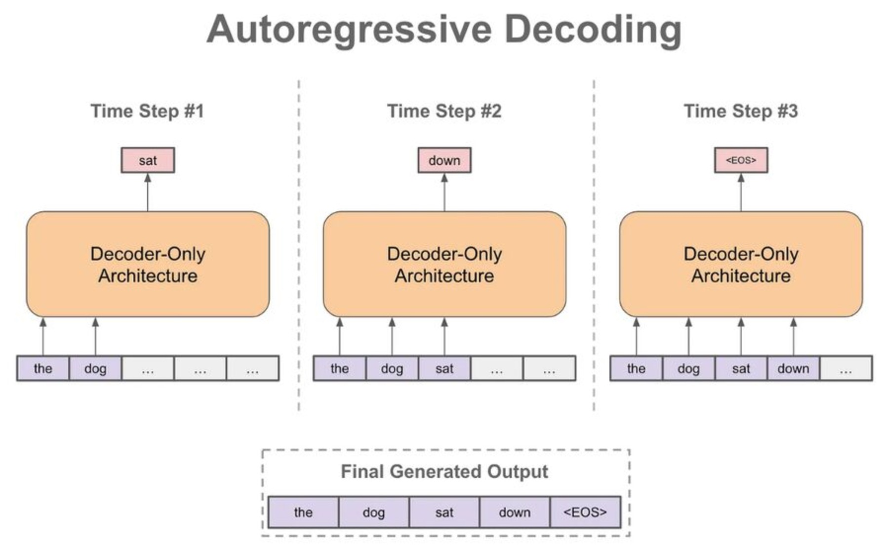
Some background: Autoregressive decoder
Transformer decoder is a transformer that applies self-attention only to past vectors
Can be used for text generation ("autoregressive decoding"):
  Output vectors from transformer are used for producing a probability distribution over all tokens
  Highest probability token is passed back to the input
  Repeat
This architecture is used in almost all LLMs (ChatGPT, Gemini, etc)

Slide 22
End-to-end speech recognition
There are three dominant models for end-to-end speech recognition
  Encoder-decoder with attention – very similar to neural machine translation
  Connectionist temporal classification (CTC) -- similar to BERT-like model
  Neural transducer (also known as RNN-T)
Training data: speech utterances and their corresponding transcripts
  Long speech recordings have to be split into shorter chunks for training (typically max 20-30 seconds in length)

Slide 23
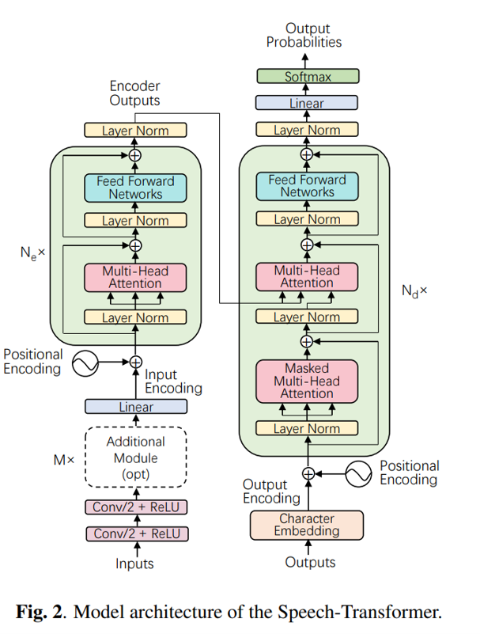
Encoder-decoder for ASR
This model transcribes speech utterances directly into output tokens
  Tokens: characters, words, or subword tokens
Consists of two submodules: encoder and decoder
  The encoder encodes filterbank features into high level features
    Typically also downsamples input features by a factor of 4, using convolutional layers
  The decoder is an attention-based token decoder
  Like LLM decoder, but also applies attention over encoder outputs

Slide 24
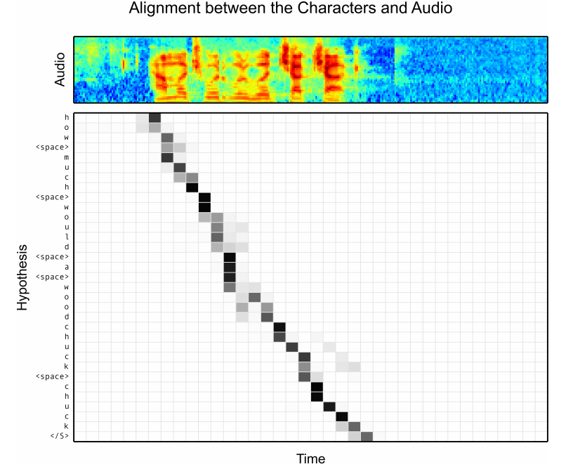
Attention visualization
On the right: Alignments between character outputs and audio signal produced by the encoder-decoder model for the utterance “how much would a woodchuck chuck”.
The attention mechanism was able to identify the start position in the audio sequence for the first character correctly
The alignment produced is generally monotonic
Can be used for producing word timestamps for recognized words

Slide 25
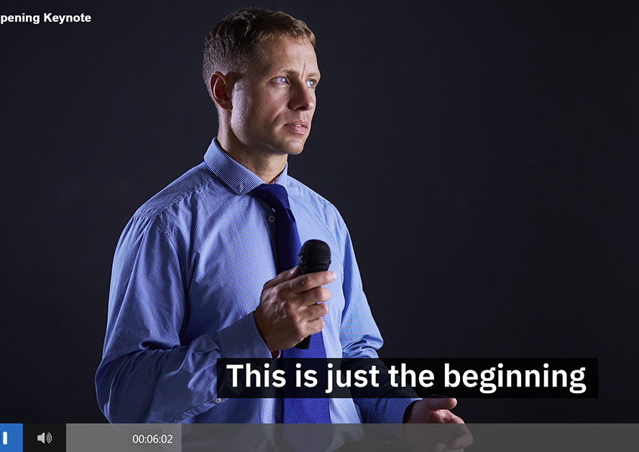
Other tasks than speech recognition
Encoder-decoder architecture can be without any changes be used for other speech processing tasks where the output is not a word-by-word transcription
  Close-captioning (transcription, but in edited form, without disfluencies, repetitions, with grammar fixed)
  Speech translation
  Speech summatrization

Slide 26
Shallow fusion with a language model
The encoder-decoder model is trained using a limited amount of transcribed speech data
But in addition, we have vast amounts of text-only data (newspapers, books, websites, Wikipedia). How to make use of such text-only data (or even a pretrained LLM?)
Language model shallow fusion: during decoding, prefer token sequences that have a high language model probability:
However, this is not a perfect solution, as we duplicate language model effects (decoder of the ASR model also learns its own internal language model)

Slide 27
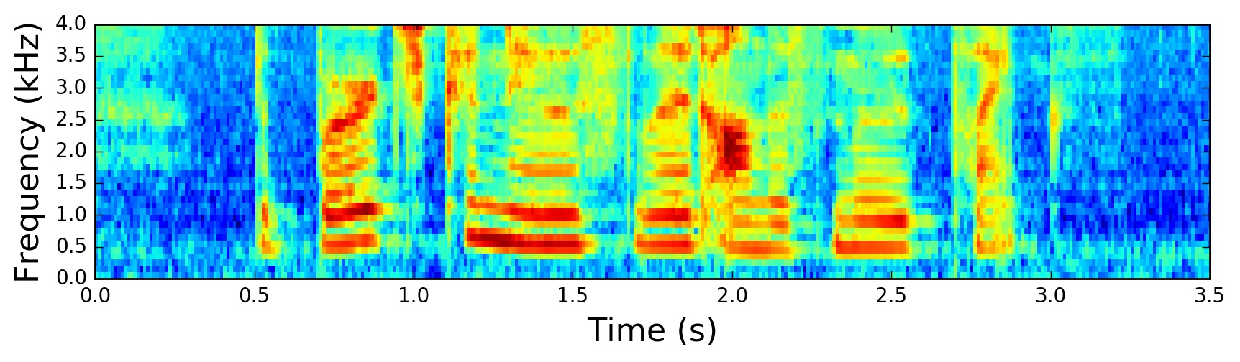
Connectionist Temporal Classification (CTC)
Actually 1st fully end-to-end ASR architecture, from ~2015
CTC allows to use a monolithic recurrent/transformer model, it doesn’t require separate encoder and decoder
For each timestep, the model outputs a probability distribution over all tokens
  This is very similar to BERT-like models, used for e.g. named entity recognition
We can get the decoded output text by simply doing argmax over all tokens for each timestep
  Or can we?
Transformer encoder

Slide 28
CTC: blank symbol
Problem: we do not have the ground truth label (token) for each timestep during training (like we have when we train word classification models)
Also, the number of output tokens is typically much smaller than the number of feature timesteps (100 features per second)
That's why CTC introduces the <blank> symbol, also sometimes called ε (epsilon)
  When the model outputs <blank>, it means that there is no new token to output at this timestep
  Actually, it's slightly more complicated
Transformer encoder

Slide 29
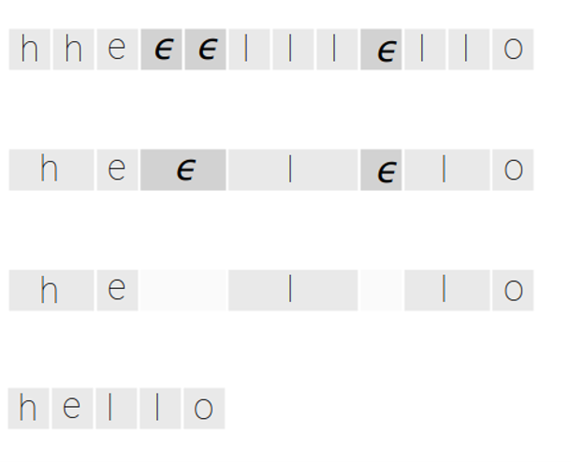
Decoding with the CTC model
CTC model outputs one token for each frame
During post-processing
  Repeated characters are merged
  Epsilons are deleted

Slide 30
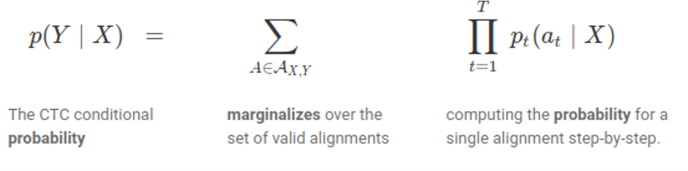
CTC loss function
But how to train a CTC model?
  The exact ground-truth label for each frame in the training data is not known
  We only know the ground truth token sequence for the utterances
Solution: CTC loss function
  Marginalizes (sums) over all set of alignments that produce the same character sequence

Slide 31
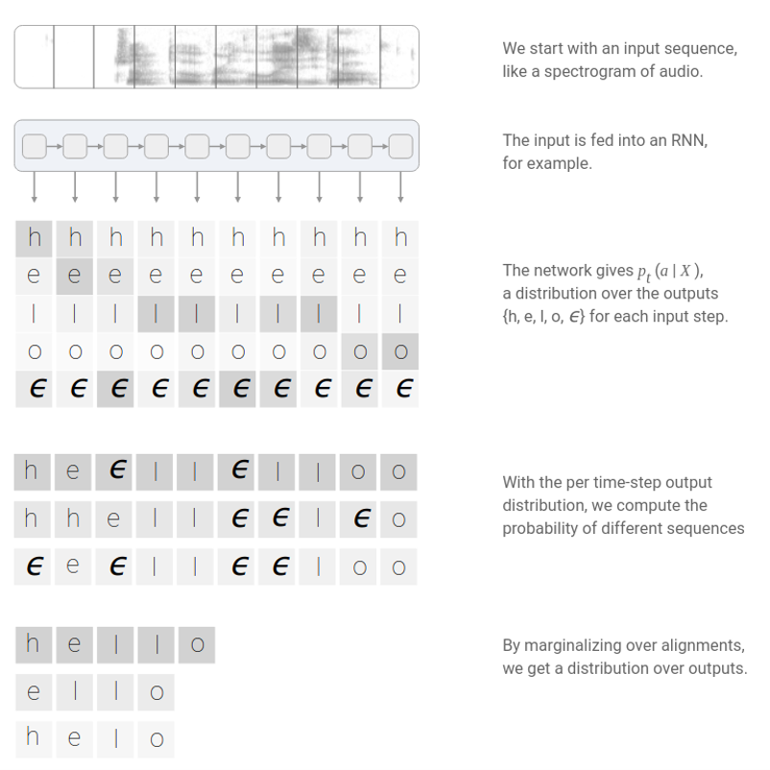
CTC loss, summarized

Slide 32
CTC performance
CTC has similar performance as encoder-decoder, when training on ~1000 hours of data
CTC is extremely fast on a GPU when used without an external language model, since no beam search based autoregressive decoding is needed
One hour of speech can be decoded in ~30 seconds using a relatively large model
CTC model benefits a lot of from shallow fusion with a language model (but it makes decoding slower)

Slide 33
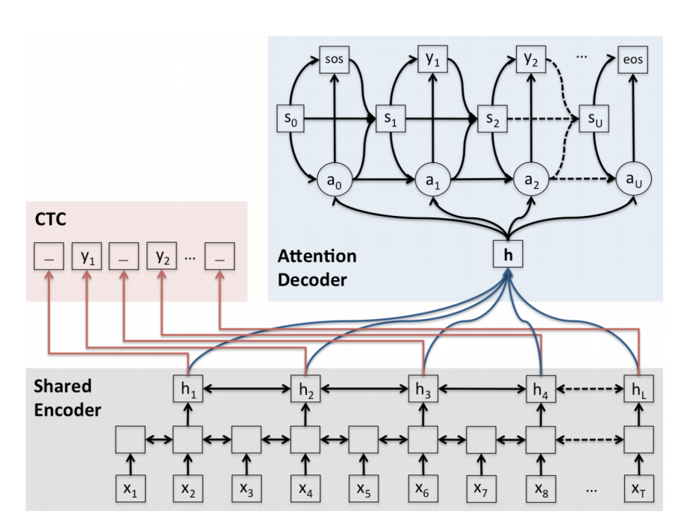
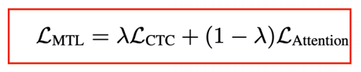
Joint CTC-seq2seq
Problems:
  Encoder-decoder model is hard to train from scratch, especially on long utterances
  Too much flexibility: in ASR, decoded items are always monotonic with regard to input (as opposed to MT)
CTC models don’t have these problems since they impose left-to-right constraints
Solution: use the encoder as a secondary CTC model when training
Decreases WER by ~10% in many cases

Slide 34
RNN Transducer: why?
Problems with encoder-decoder models
  The attention operation is expensive for long input sequences
  Attention models cannot be run online (in real time), since the entire input sequence needs to be available before the decoder can attend to it
Problem with CTC:
  The outputs are assumed to be independent of each other
  The result is that CTC models often produce outputs that are obviously wrong, like “I eight food” instead of “I ate food”
  Getting good results with CTC usually requires a search algorithm that incorporates a secondary language model (unless you have lot of data and very large model, in which case the model learns to avoid such errors automatically)

Slide 35
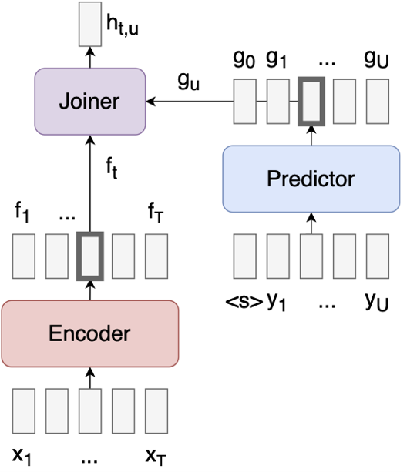
RNN-T: architecture
Also called Neural Transducer (since it doesn’t need to use RNN)
Consists of three modules:
  Encoder: similar to the encoder used in CTC and attention models
  Predictor: doesn’t see acoustics at all -- actually a language model and can be pretrained
  Joiner: predicts a character (or epsilon) for the current timestep based on the acoustic encoding f and language model state g

Slide 36
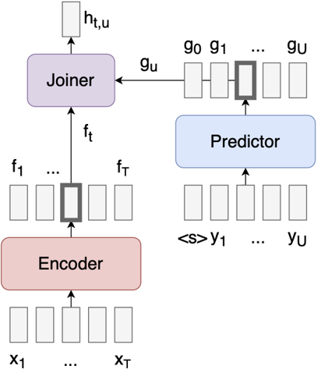
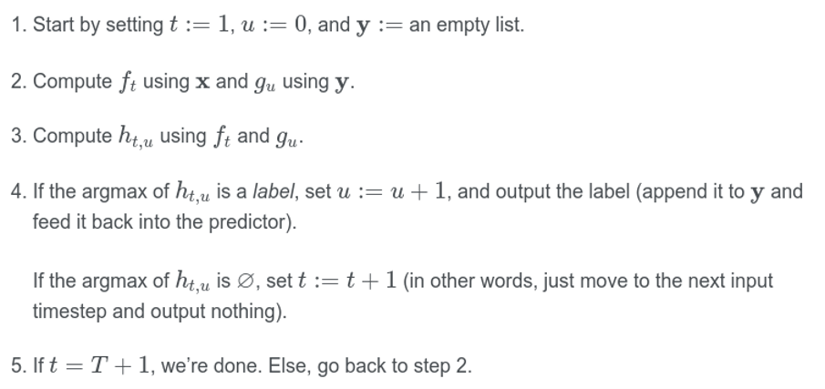
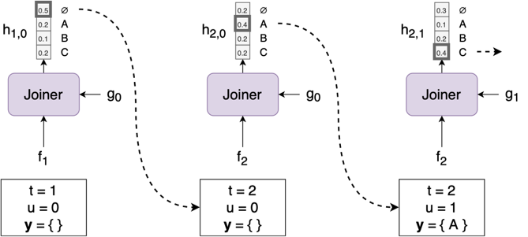
Transducer: greedy decoding
If the encoder is causal (i.e., only relies on past inputs), then the search can run in an streaming fashion, where we process each x as soon as it arrives.
The predictor only has access to y, and not x—unlike the decoder in an attention model, which sees both x and y. That means we can easily pre-train the predictor on text-only data, which there’s a lot more of than paired (speech, text) data.

Slide 37
Neural transducer: training
During training, we don’t know the correct alignment between characters and timesteps
Hence, during training we need to sum over all possible alignments that produce the desired character sequence (similarly to CTC)
  This is extremely memory hungry
That’s why (early) Transducer models have been mostly developed by Google that has TPUs for training
  Recent breakthroughs (approximations) allow training with reasonable GPU RAM
  E.g., we only use limited history in the Predictor
However, decoding is fast and doesn’t need much memory
Runs natively on Android phones
Currently the most widely used streaming ASR model
  Used in Kiirkirjutaja (Estonian ASR system that also powers the automatic realtime subtitling in Estonian TV)
Problems: cannot make effective use of long range contextual relationships of tokens, since Predictor is typically a bigram (but Encoder learns to help it a bit)

Slide 38
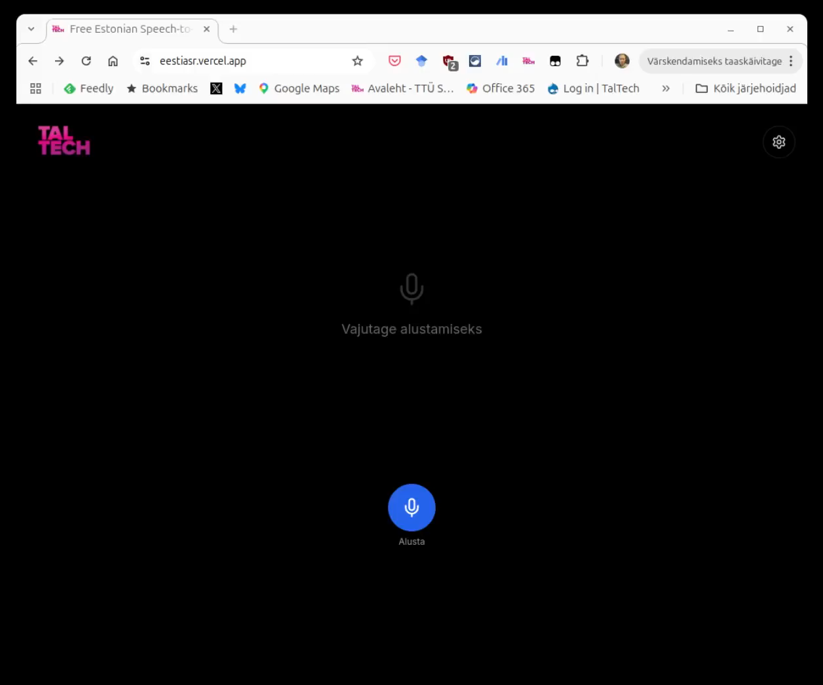
Neural transducer: Estonian demo

Slide 39
Three architectures: comparison
Comparison on Gigaspeech dataset
10K hours of training data, English
Various domains: Youtube, podcasts, audiobooks
The three architectures are surprisingly similar in accuracy, when well-tuned for a particular task
Contributor | Train Recipe | Test WER
Baseline | Transformer seq2seq + RNNLM | 12.70
Baseline | Conformer/Transformer-seq2seq | 10.80
Baseline | RNN-T | 12.30
Johns Hopkins University | Transducer: Zipformer encoder + Embedding decoder | 10.38
Johns Hopkins University | Pruned Stateless RNN-T | 10.51
Johns Hopkins University | Conformer CTC + ngram & attention rescoring | 10.58
Mobvoi | Joint CTC/seq2seq | 10.60
ByteDance AI Lab | Transformer seq2seq | 11.60

Slide 40
Conclusion
Speech is a complex signal, has a lot of variety
Feature extraction: converting waveform to vectors (50 or 100 per second)
Three dominant speech recognition models
  Encoder-decoder: most powerful, can be used for other tasks like speech translation
  CTC (encoder only), often with an additional language model: fast
  Neural transducer: allows streaming processing

